Slide 1
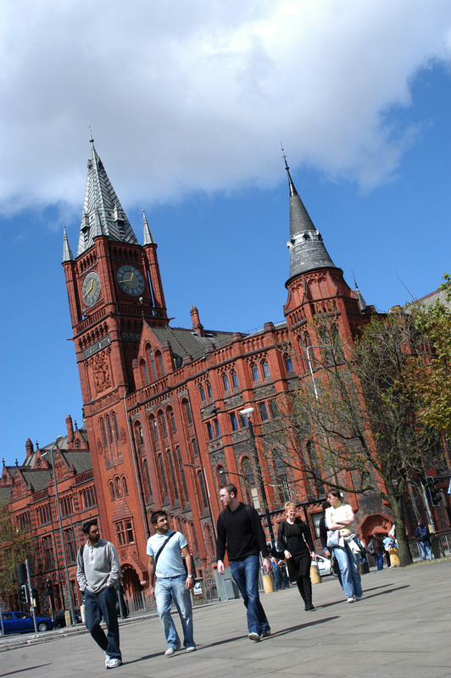
Why it is difficult to find and retain clinical teachers
David Taylor
Liverpool Medical School, UK

Slide 2
Liverpool Medical School
Uses Problem-based learning to help students learn basic medical sciences in a clinical context and encourage life-long learning.
Teaches clinical skills from the first day
Provides organised intensive clinical contact from the second year

Slide 3
Liverpool continued...
Clinical learning is weighted 1/3 community, 2/3 hospital
Has the “final exams” at the end of the fourth year
And has a fifth year clinical apprenticeship assessed by portfolio.

Slide 4
Problem
We have around 350 students each year on a programme with high demand for clinical teachers at each stage of the endeavour.
The National Health Service is placing greater demands on its clinicians.
The students have higher expectations, and are surveyed externally in the National Student Survey.

Slide 5
So why is it difficult to find and retain clinical teachers?

Slide 6
Previous studies
There are several previous studies which indicate the following possibilities:
primacy of research,
lack of recognition/professional identity for teaching,
Kumar, K., Roberts, C., & Thistlethwaite, J. E. (2011). Medical Education, 45(5), 497-503.
lack of support,
lack of knowledge of programme,
lack of skills development.
Stark, P. (2003). Medical Education, 37(11), 975-982.

Slide 7
Current study
Clinical academics, who contribute actively to the medical curriculum, were interviewed (about 1 hour).
The interviews were transcribed verbatim and the transcripts checked with the interviewee.
Interviews are still underway, so the coding/recoding cycle is not complete...
but after 10 interviews with active senior clinical academics

Slide 8
Results
We have evidence for agreement with the main 5 themes
And four other (positive) themes.

Slide 9
Negative themes
The lack of recognition/career progression for teaching
Lack of support for teaching
And less commonly mentioned
Lack of knowledge about “what to teach”
Lack of training as teachers

Slide 10
Positive themes
Students
Apprentices
Role model
Making things better

Slide 11
Negative and Positive
The difficulty of balancing teaching/research and clinical commitments
Although there are frustrations, there is a recognition (from the most senior interviewees), that this is one of the things that makes the job interesting.

Slide 12
Lack of recognition
...it used to be much better say 20 years ago, when honorary lecturer status was given out in recognition of good input, and was respected. People were brought together for example the examiner's dinner and examiners meetings as well. (Christopher)
...Well, things like your role not being actually explicit, acknowledged, rewarded, whatever. Sometimes makes certain aspects of your role difficult, because you'll always be competing...(Ann)

Slide 13
Continued...
...I don't think that teaching is valued in any way shape or form, certainly from my experience. And that is very disheartening, and a lack of career path I think for people who are trying to juggle all these things together, who are clinical academics.(Bea)
...the University could raise the status of medical student teaching within our NHS environment (Bob)

Slide 14
Lack of support for teaching
I'm flabbergasted by the support I've had from the clinicians. (Christopher)
...and we still work well together, we still back each other up we still support each other (Alan)
... Just makes me think how sad it is, that I don't think is the University's job to support me in that respect. (Bob)

Slide 15
continued
..I think it would be better if we got on a bit better.... We are all in our little silos.... (Claire)
..I think, being proactive, and trying to liaise with other years...we don't do enough of that (Douglas)

Slide 16
Lack of knowledge of what to teach
... A lot of consultants come up and say “What do you want to talk about”? (Douglas)
... A lot of clinical teachers are confused about what they should be delivering at (any particular) stage of the curriculum. (Douglas)

Slide 17
Lack of skills development
.... You need skills, you need training probably (Douglas)

Slide 18
Students
...is actually contact with younger people that are bright, and stimulating. It keeps me on my toes, I actually enjoy it 99 times out of 100. (Bob)
They are on the ball, they are respectful, they are well-behaved great kids who are going to make super doctors. So I enjoy the teaching and the benefit of the PBL session especially is getting to know the students over a longer time. (Bob)

Slide 19
Apprentices
My first students qualify this year they came to me a few years ago, some of whom with really quite difficult issues. That is very rewarding, you do feel that you have a role in that apprenticeship type relationship (Bob)
as a clinical academic most of my time is spent in hospital seeing patients, and working in a teaching hospital in an environment where the students are around to learn from you (Bea)

Slide 20
Role model
it's very important I think the clinical academics are actually seen as role models as good-quality clinicians, as well as researchers (Christopher)
I think there is also the role of the experience you have as an individual going through medical school, what that means to an individual (Bea)
I remember role models when I was a medical student. I think part of the privilege of being a consultant is being a role model...(Alan)

Slide 21
Making things better
...I was always feeling that, if ever I was in that position I would do it a different way. Because of the way get treated, you remember the good ways and the bad ways and part of that is about “don't forget what it feels like to be a first-year medical student and to be completely at sea”. (Ann)

Slide 22
Balance
...I think the biggest frustration, what has been and probably will continue to be, there is an absolute requirement for us to perform with original research output and grant income. (Bob)
...Okay, the best bit is having a so-called "portfolio career", where I'm not doing the same thing every day. (Bob)

Slide 23
Solution/s?
Recognise the commitment that our colleagues give to the educational process –and to the students.
Training, support, nurturing

